Slide 1


Capstone Project
www.utiva.io

Slide 2


CASE SCENARIO
The Palmoria Group, a manufacturing company based in the Nigeria is embroiled in issues bordering on gender inequality in its 3 regions. Unfortunately, the media recently published in the news with the headline “Palmoria, the Manufacturing Patriarchy” This doesn’t look good for the owners of the business based on their ambition to scale the business to other regions and even overseas. Cases like this can only spiral downwards revealing other issues like gender pay gap amongst other possible issues.
The CEO of Palmoria, Mr Ayodeji Chukwuma is keen to address these issues before it gets out of hands. The CHRO, Mr. Yunus Shofoluwe has been assigned the task to identify key areas within the business that could spring up issues and address them immediately.
Mr. Shofoluwe decided to recruit you as a HR Analytics expert to analyse the company’s HR data and come up with recommendations for management’s attention. “Now, the future of gender equality in Palmoria lies in your hands” the exact words of Mr. Shofoluwe before he handed the data to you

Slide 3

Required:
Analyse the company data and generate insights that Palmoria management team would need to address
Your analysis should be visualized using appropriate charts
Your focus should be on gender related issues within the organization and its regions
The insights required are based on your own discretion. However, Mr. Gamma as an insider has offered to give you pointers into areas you need to pay attention to

Slide 4

Pointers from Mr. Gamma
Generally, there are two genders in the organization. However, some employees refused to disclose their gender. You would need to assign a generic gender status to these employees
Some employees are without salary because they are no longer with the company. You will need to take those employees out
Lastly, some departments are indicated as “NULL”. These department would also need to be taken out

Slide 5

Case Questions
What is the gender distribution in the organization? Distil to regions and departments
Show insights on ratings based on gender
Analyse the company’s salary structure. Identify if there is a gender pay gap. If there is, identify the department and regions that should be the focus of management
A recent regulation was adopted which requires manufacturing companies to pay employees a minimum of $90,000
Does Palmoria meet this requirement?
Show pay distribution of employees grouped by a band of $10,000. For example: How many employees fall into a band of $10,000 – $20,000, $20,000 – $30,000 etc. Also visualize this by regions

Slide 6
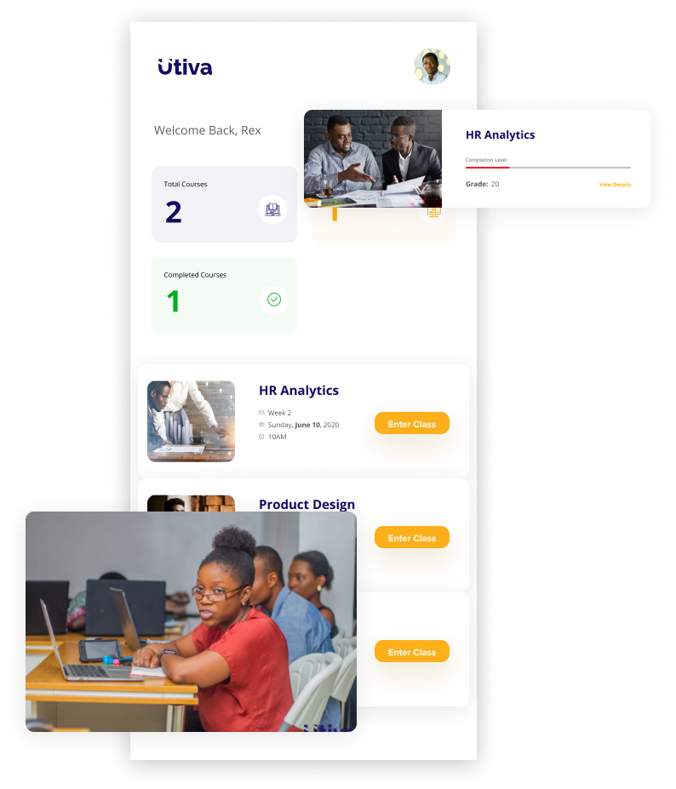
Case Questions
5. Mr Gamma thought to himself that since you were already working on the employee data, you could help out with allocating the annual bonus pay to employees based on the performance rating. He handed another data to you that contains rules for making bonus payments and asked you to
calculate the amount to be paid as bonus to individual employees
Calculate the total amount to be paid to individual employees (salary inclusive of bonus)
Total amount to be paid out per region and company-wide

Slide 7
Submission
Upload your work to the E-learning platform (app.utiva.io/signin)

Slide 8
DataSets
Please click here to view the datasets you will be using for this project

Slide 9
Utiva HQ
3400 Prospect Street NW Washington,
DC 20007
+1 202 931 9842
Nigeria:
1A Hughes Avenue, Alagomeji, Yaba
+234-806-211-1308 | www.utiva.io

